Slide 1



SIVYX – UNIX Based OS DEMO
OS Demo showing file and
process subsystem features

Slide 2
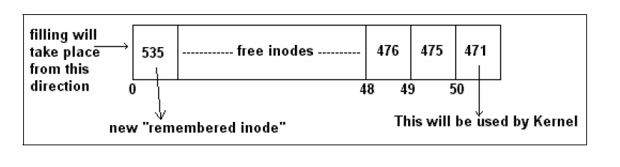
Why sivyx ?
Operating System is such a subject that seems to be easy when it is learned first time. But as we go deeper and deeper inside it, we get to know that this thing also have many tricks and errors hidden it, but due to our overlooking they are getting ignored
Difficulty with OS like UNIX is that their basic structure is also so much complex due to which finding flaws (which are really present)and correcting them with maintaining all the compatibility of system is very challenging

Slide 3
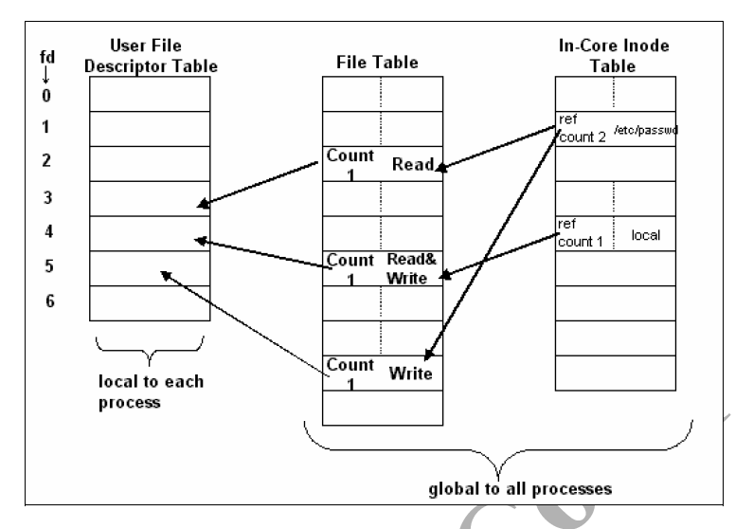
Goals to achieve
To implement and understand some features of UNIX FS(File Subsystem) and UNIX PS (Process Subsystem) and elaborate them neatly in project
Adding some self features into SIVYX like
actual tree like file system to the OS
Keeping one address of buffer throughout the memory for accessing
Memory management at some extent
If possible handling process by self control without any involvement of kernel

Slide 4
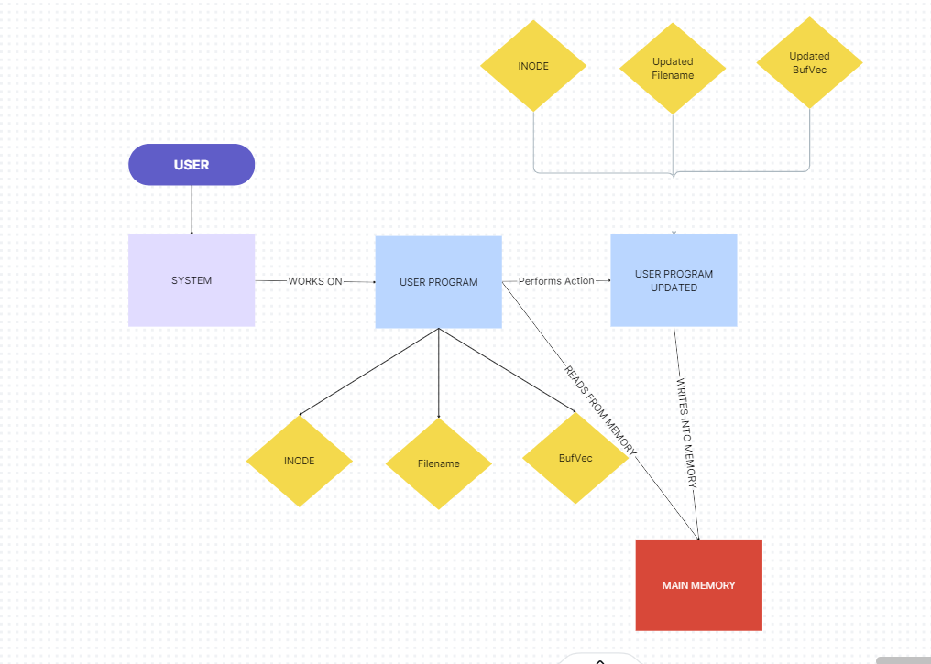
WORKFLOW OF SYSTEM

Slide 5

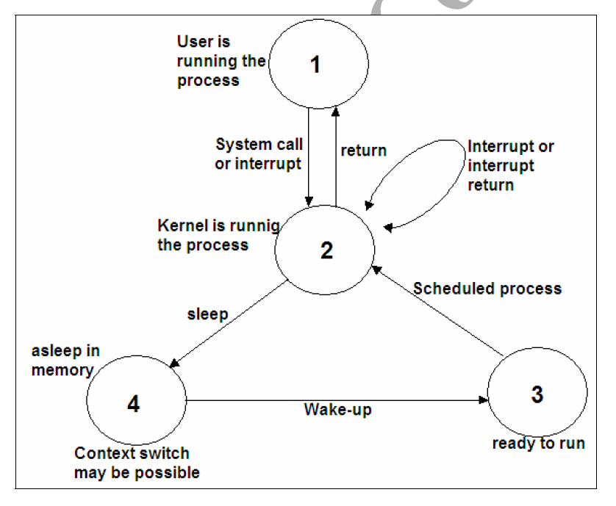
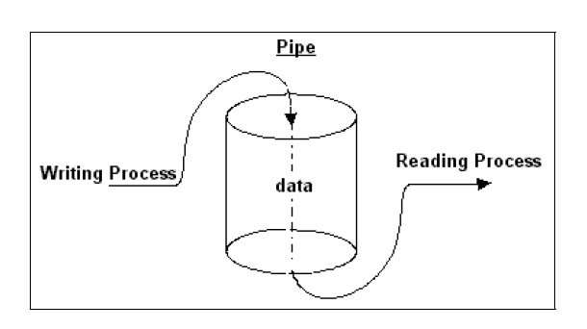
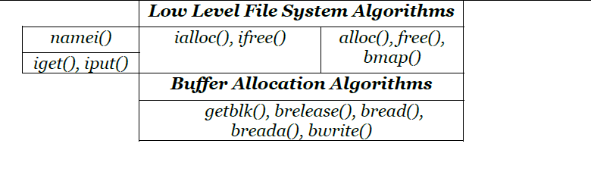
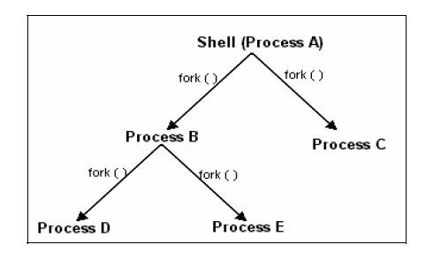
Main components
FILE
PROCESS
INODE
BUFFER

Slide 6
METHODOLOGY
Buffer
Inode
Buffer Number
Buffer Space
Inode Number
Corresponding File
Main Memory
Files
IVT
BT
BufVEc
FILE
Corresponding Buffers
Corresponding File
BufVec
INODE

Slide 7
TOOLS and Appliances used
Help Taken From
Design of UNIX System :- Maurice J. Bach
Magic Garden
Astromedicomp Notes :- Dr. Vijay D. Gokhale
Software Requirements
C++ (At least 2011 Version)

Slide 8
implementation
Buffer
INODE
File
Structure of Buffer
Free List of Buffers (Class)
Add Buffer
Allocate Buffer
Show List
Buffer Pool (Class)
Create Buffer
Add Buffers To Free List
WriteToBuffer (Function)
BufVec (Class)
Insert Buffer
WriteToBuffer
ClearBufVec
CopyBufVec
LinkBufVec
Structure of Inode
Free List of Inodes (Class)
Add Inode
Allocate Inode
Show List
Inode Pool
Create Inode
Add Inodes to Free List
Files (Class)
ShowInfo
Write
DisplayContent
showInode
showBuffers
Clear
Copy
Link

